Slide 1

ODI Group 1
SOTON BOT

Slide 2

What is SOTON BOT?
Buddy on Messenger you talk to using natural language to help you find rooms to book, buses to take, places to eat and more!
Facebook Messenger API
Natural Language Processing API.AI
Open Data

Slide 3
Why SOTON BOT?
Effortless information retrieval
Messenger has highest adoption rate
Personalized, intelligent responses
No more using 5 different websites that many don't even exist!

Slide 4


What can SOTON BOT do?
Find Buses
Find Essentials
Locate Places To Eat
Access Room Details
Discover Campus Buildings
Where is the nearest bus stop?
What bus takes me to civic centre?
Where can I get a U1A?
How can I get to civic centre?

Slide 5
What can SOTON BOT do?
Find Buses
Find Essentials
Locate Places To Eat
Access Room Details
Discover Campus Buildings
Where can I get vaccination?
Car parking
Where can I get some alcohol?
Where is an atm?

Slide 6
What can SOTON BOT do?
Find Buses
Find Essentials
Locate Places To Eat
Access Room Details
Discover Campus Buildings
Where can I get some coffee?
Where can I find some pizza?
Food please!

Slide 7
What can SOTON BOT do?
Find Buses
Find Essentials
Locate Places To Eat
Access Room Details
Discover Campus Buildings
Find me a room tomorrow
Is there a free room Monday 3pm?
Find a free room next week Tuesday?
How can I get to civic centre?

Slide 8
What can SOTON BOT do?
Find Buses
Find Essentials
Locate Places To Eat
Access Room Details
Discover Campus Buildings
Where is building 32?
Where can I find building 7?

Slide 9
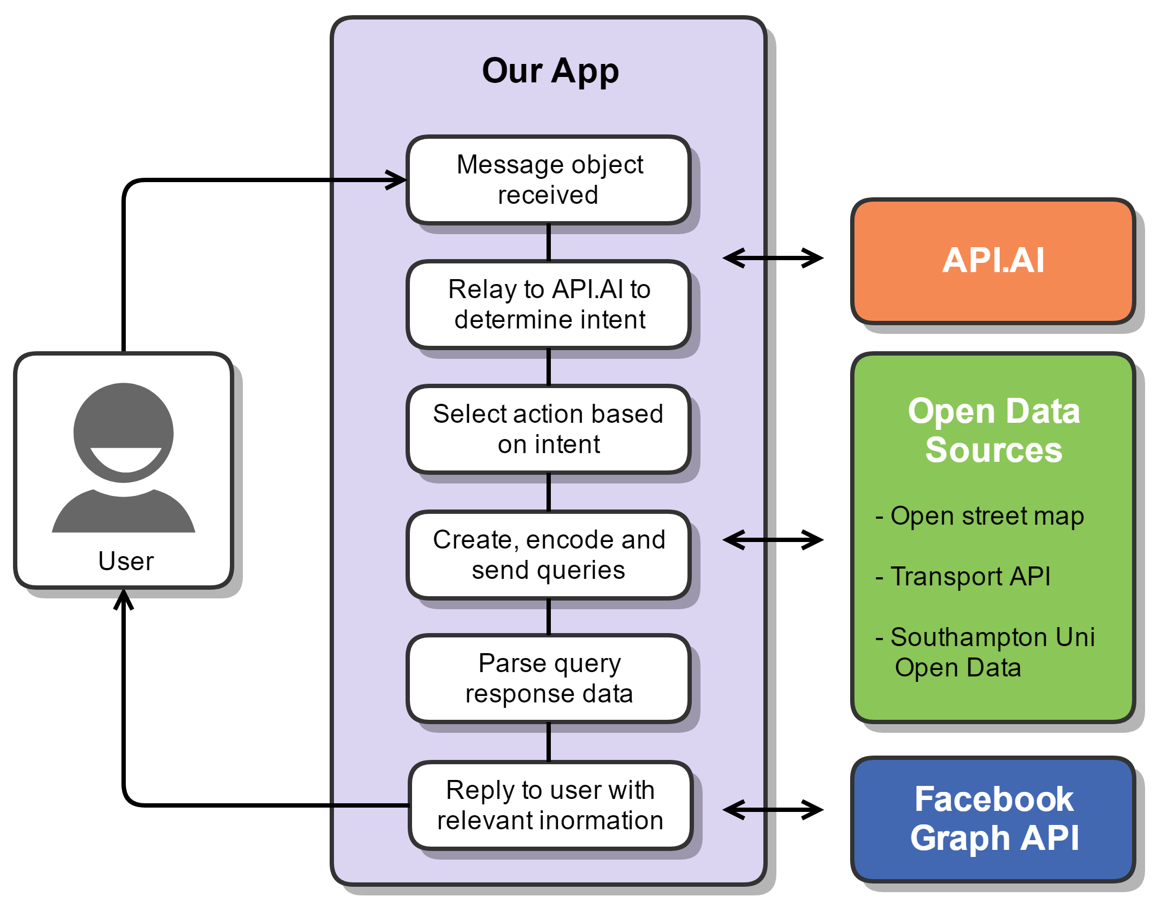
How?

Slide 10
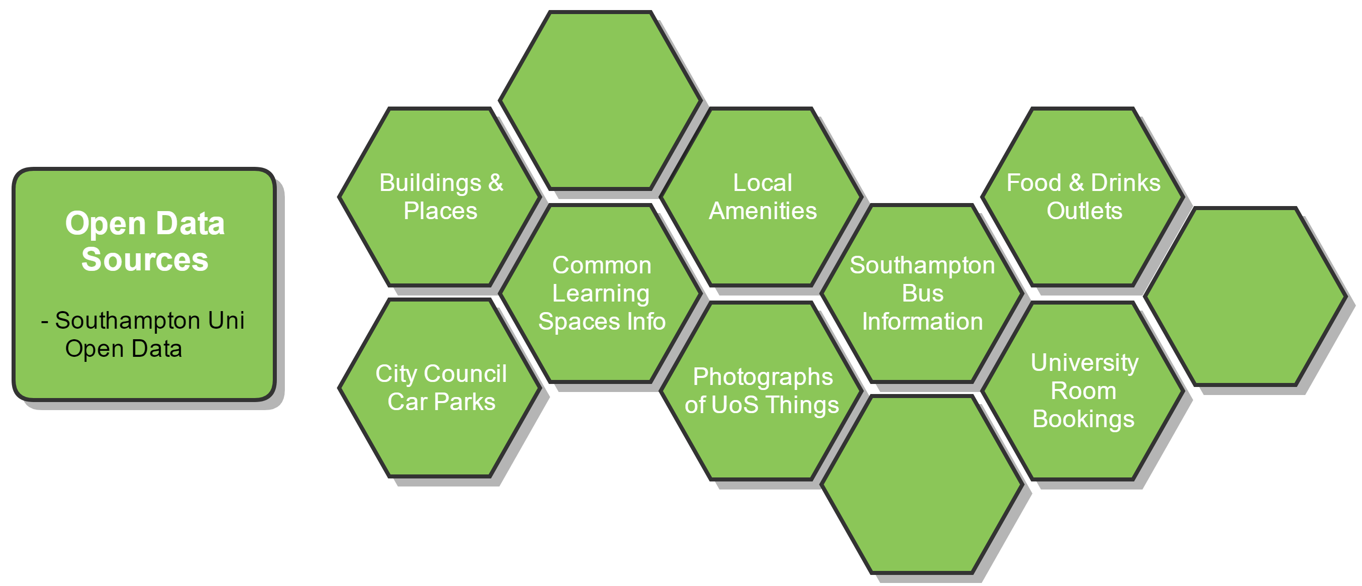
Southampton Open Data

Slide 11
Questions

